Slide 1
Data Dissemination and Management - Topics
Introduction
Challenges – Lecture 9
Data Dissemination Lecture 10
Mobile Data Caching Lecture 10
Mobile Cache Maintenance Schemes - 10
Mobile Web Caching Lecture 11
Summary

Slide 2
Data Dissemination and Management – Introduction (cont.)
Mobile Information Delivery Methods
  Push (Publish-Subscribe) Mode
    Information broadcasting when its available
    Resource-efficient
    Scalable
Some of this information is explicitly “pushed” to us via such mechanisms as television and radio advertisements, telemarketing, electronic billboards, and flyers in the mail.
Other information we explicitly seek and “pull” onto our laptops to read.
Information in which we are interested can be obtained through two modes: on-demand and publish-subscribe.
  Pull (On-Demand) Mode
    User send query for particular information to an information source (server or peer)
    Reply
  Information Caching
    Document, files

Slide 3
Data Dissemination and Management – Introduction (cont.)
Issues of Mobile Information Services
  Publication Content: Which items
  Publication Frequency: How often
  Bandwidth Allocation:
    Uplink channels
    Downlink channels
    Adaptive to usage pattern in a cell
  How can mobile users access services transparently?
    Broadcast channels, directory channel

Slide 4
Data Dissemination and Management - Introduction (cont.)
Wireless Communication Problems
  Physical Medium
    Signal Fading
    Path Loss
    Interference
    Time dispersion
  Lower bandwidth
  Higher error rates
  Higher communication latency

Slide 5
In the on-demand mode (also known as pull mode), we (the information sink) send an explicit query every time we need particular information to an information source (a server or a peer).
The information source sends back the latest version of the requested (or queried) information.
The access latency in the on-demand mode therefore is at least the round-trip latency. In addition, the sender has to expend resources to send the query every time it needs the information.
The publish-subscribe mode (also known as push mode) is used for obtaining information whenever it is available. For example, we can subscribe to a stock ticker, and whenever the stock information is updated, it will be sent to us.

Slide 6
Publish-subscribe mode - In mobile computing, the publish-subscribe mode is combined with the broadcast nature of wireless communication to provide resource-efficient and scalable information delivery.
Wireless transmission is characterized by such problems as signal fading, path loss, interference, and time dispersion.
These lead to higher error rates and signal distortion. A consequence is that wireless links have a lower bandwidth and a higher communication latency.
Providing information services to mobile clients is an important application of publish-subscribe mode of data dissemination.
Examples of information services include financial information services, airport information services, and emergency services for traffic information.
Wireless information services can be classified into picoservices, macroservices, and wide area services based on the area of coverage (cell sizes).

Slide 7
The following are some issues in providing wireless information services :
How to structure an information server to provide wide area services? Some issues in this regard are Publication content: Which items to publish?
Publication frequency: How often to publish? Bandwidth allocation: How to adaptively allocate bandwidth between uplink and downlink channels to reflect the changing usage patterns in a cell?
How can mobile users access services transparently? A simple way to accomplish this is to provide the user with a directory channel that has information about all the broadcast channels available in the new cell.
When mobile hosts are accessing data, how can their energy consumption be minimized?
*Some items are requested more frequently than others.

Slide 8
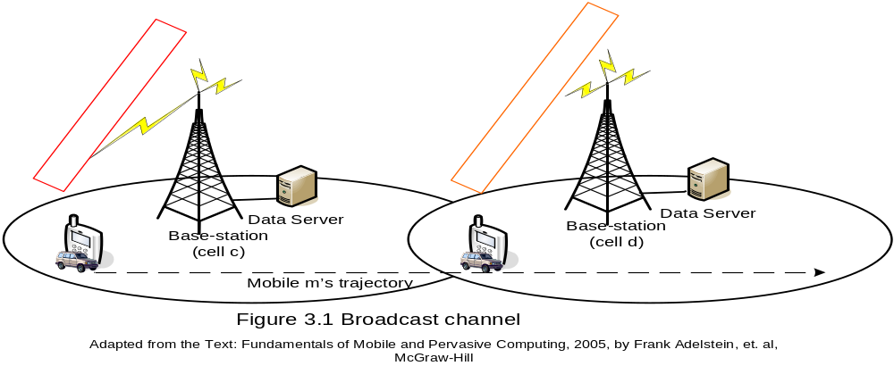
Data Dissemination and Management – Introduction (cont.)
How can mobile users access services transparently?

Slide 9
Data Dissemination and Management – Introduction (cont.)
  How can their energy consumption be minimized? (Energy efficient Info services)
    CPU in “doze mode”
    Low-power radio circuit – matching a predefined set of packet address
    Store data in a low-energy buffer
    Wake-up the CPU after a certain time interval
    Run CPU clock in a low-power mode

Slide 10
Data Dissemination and Management – Introduction (cont.)
  Publish-subscribe
    Conserves battery power since no uplink query is needed
    More scalable – access time independent of the number of mobile hosts requesting the data
    More useful in asymmetric environments

Slide 11
Data Dissemination and Management – Introduction (cont.)
  Information caching
    Caching to avoid frequent access
    Replenish on an as-needed basis or in a predictive manner
    Hoarding items that are in short supply and become available only occasionally
    How to guarantee the consistency of cached information

Slide 12
Data Dissemination and Management - Challenges
Challenges
  Architecture-based
  Architecture-less
Environment Challenges
  Intermittent Power
  Intermittent Connectivity
  Long Travel Times
  Variable Population Density
  Lack of Secure Storage
User Challenges
  Mobile Workforce
  User Education Levels

Slide 13
Data Dissemination and Management - Challenges
Architecture-Based Cellular Mobile Networks
  Weak Connectivity
  Severe Resource Constraints
  Asymmetric Communication Links
  Location and Time (context) Dependent
Architecture-less Mobile Ad Hoc Network (MANET)
  Weak Connectivity
  Severe Resource Constraints
In both types of networks, the wireless links may be of low bandwidth (in comparison with wired links) and subject to frequent disconnections, leading to weakly connected mobile clients.
Consequently, mobile clients often can be disconnected from their data servers. These disconnections can be either voluntary [e.g., when the user disables the wireless network interface card (NIC) to conserve battery power] or involuntary (e.g. when the user moves to an area where wireless service is not available).

Slide 14
First characteristic of some wireless networks is - Weak connectivity of mobile clients in a mobile wireless computing platform creates a new challenge for data management
  how to ensure high data availability in mobile computing environments where frequent disconnections may occur because the clients and server may be weakly connected. Ex. Coda
A second characteristic of mobile computing environments is the severe constraints on the availability of resources (such as battery power) at the mobile node. A typical node in such environments has limited power and processing resources.
  This characteristic leads to another challenge for data management in mobile computing environments, specifically, how to minimize resource consumption (e.g., energy and bandwidth) for data management while ensuring a desirable level of data consistency.

Slide 15
The third characteristic of some wireless networks is the presence of asymmetric communication links.
  For example, in architecture-based wireless networks, the downstream (base station to mobile nodes) communication link capacity is usually much higher than the upstream (mobile to base station) capacity. To make matters worse, mobile nodes may have to compete with several other mobile nodes to get access to an upstream channel (using some medium access techniques, such as ALOHA).
The fourth characteristic of mobile computing environments is that data may be location- and time (context)–dependent.
  For example, a mobile user may query various databases periodically to retrieve both location dependent and time-dependent information.
Context-dependent data impose another problem for cache management algorithms—
  The decision to cache or replace a data item now also depends on the context (e.g., location) of the mobile node, in addition to the temporal or spatial locality in the reference pattern.

Slide 16
Data Dissemination and Management - Challenges
Architecture-less Mobile Ad Hoc Network (MANET)
  Weak Connectivity
  Severe Resource Constraints
Data availability and bandwidth/energy efficiency still need to be addressed
Can the data management schemes used developed for an Cellular Mobile Networks be used directly to solve problems in a MANET? ---- No…..

Slide 17
Data Dissemination and Management - Challenges
Gateways of MANET/Cellular Mobile Networks
  Gateways (MANET) – unreliable mobile computing devices
  Base Stations – reliable dedicated networking devices
  MANETs Remote Communication Links
    Unreliable, Low Bandwidth Links: Radio Frequency Wireless Links
    High-latency, unreliable Links: Satellite channels
  Base Stations Remote Communication Links
    High-speed wired networks

Slide 18
Data Dissemination and Management - Challenges
Network Architectures of MANET/Cellular Mobile Networks
  Peer-to-peer (P2P) networks – MANETs
  Client-Server – Cellular Mobile Networks
  Data Management Approaches
    Cooperative Caching
    Caching hierarchy – backbone caches
    Hyper Text Transfer Protocol (HTTP)
    Internet Caching Protocol (ICP)

